Slide 1
EXPLAINABLE AI-POWERED EARLY HEART FAILURE PREDICTION USING ECG SIGNALS
Presented by
PRAGATHEESVAR A
MOHAMED NIFRAS S.S
POOVARASAN K
PARTIBAN S
PRADEEP S
AI & DS
DHANALAKSHMI SRINIVASAN COLLEGE OF ENGINEERING
COIMBATORE,INDIA
Predicting Heart Failure Risk Up To 5 Years Earlier Using Explainable Artificial Intelligence

Slide 2
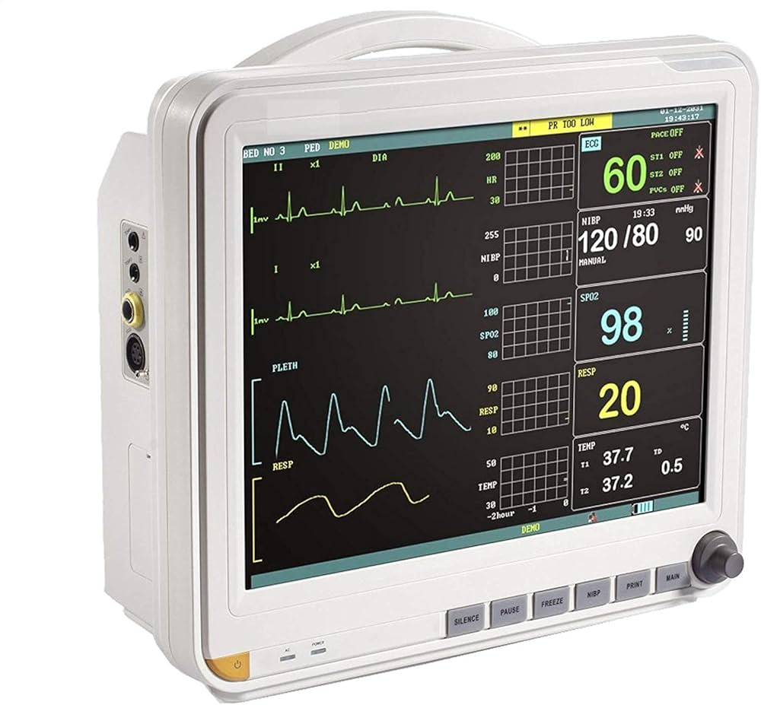
INTRODUCTION
Heart failure is a serious medical condition where the heart cannot pump blood efficiently.
It affects over 64+ million people worldwide.
• Early detection is crucial to improves survival and reduce complications.
• Traditional diagnosis often happens after symptoms appear.
Our AI system analyzes 24-hour ECG data to predict risk up to 5 years early
64+ Million cases worldwide
Early Risk detection
AI-Based Analysis system
24-hour ECG Monitoring
upto 5 years early detection

Slide 3

SUSTAINABLE DEVELOPMENT GOALS (SDG)
• SDG 3: Good Health and Well-being
• Our AI system helps in early detection of heart failure
• Reduces death rates through early diagnosis
• Supports affordable healthcare using AI technology
• Helps rural and low-resource areas with accessible screening
• Promotes preventive healthcare instead of reactive treatment

Slide 4
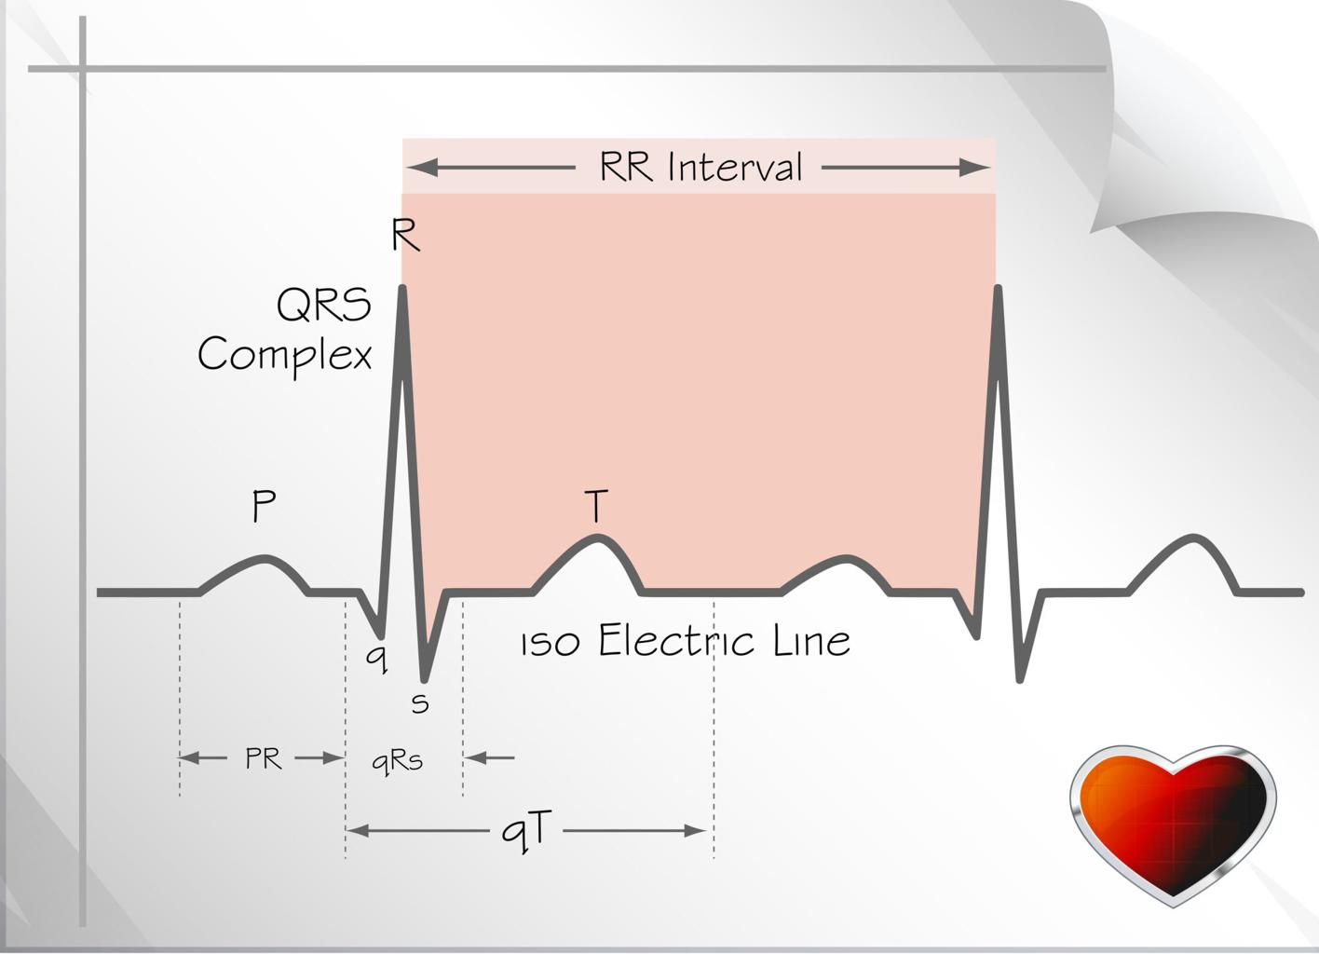
PROBLEM STATEMENT
• Heart failure is causes millions of deaths globally each year
• Early-stage symptoms are often unnoticed or ignored.
• Traditional diagnosis is slow, expensive, and reactive
• large ECG datasets are difficult to analyze manually.
• An intelligent AI system is required for fast and early risk detection.

Slide 5
PROPOSED SOLUTION
An AI-based system for automated and accurate ECG analysis.
• Continuously monitors long-term heart activity(24- hour ECG)
• Detects hidden patterns using advanced machine learning models
• Predicts heart failure risk at an early stage.
• Sends real-time alerts for faster and life-saving decisions.
ECG DATA
PRE PROCEESING
AI MODEL ANALYSIS
RISK PREDICTION
ALERT SYSTEM

Slide 6
METHODOLOGY
ECG signals are collected from patient monitoring devices.
• Data is preprocessed to remove noise and improve signal quality.
• key features are extracted to capture heart behavior patterns.
• AI/ML models analyze patterns for early risk detection.
•System predicts heart failure risk and supports timely intervention.
ECG DATA
PREPROCESSING
FEATURE EXTRACTION
AI,ML MODEL ANALYSIS
EARLY PREDICTION ( NOT ACCURACY )

Slide 7
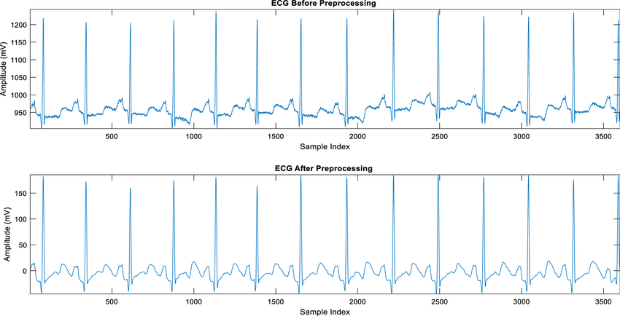
DATASET
• Real-world ECG data collected from patient monitoring systems
• captures electrical signals of heart activity over time
• Includes labeled normal and abnormal heart conditions
• Enables training and testing of AI/ML model.
• Dataset source: PhysioNet ( publicly available medical dataset)
Dataset contains large-scale time-series ECG signals

Slide 8
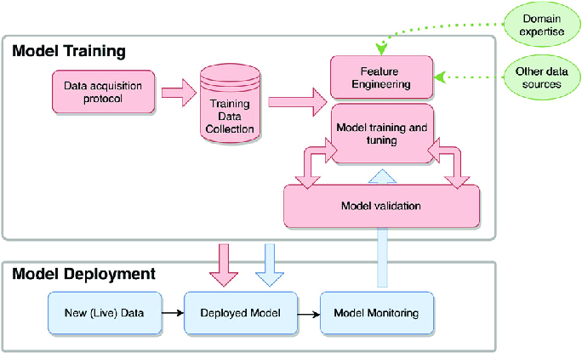
TOOLS,TECH STACK & ALGORITHMS
ML ALGORITHMS
• Convolutional Neural Networks (CNN) used for ECG pattern detection
• Support vector Machine ( SVM ) used for signal classification
• Random Forest used to improve prediction
Tools & Technologies
• Python
• NumPy, Pandas , Matplotlib for data processing
• TensorFlow/PyTorch used for model training and deployment

Slide 9
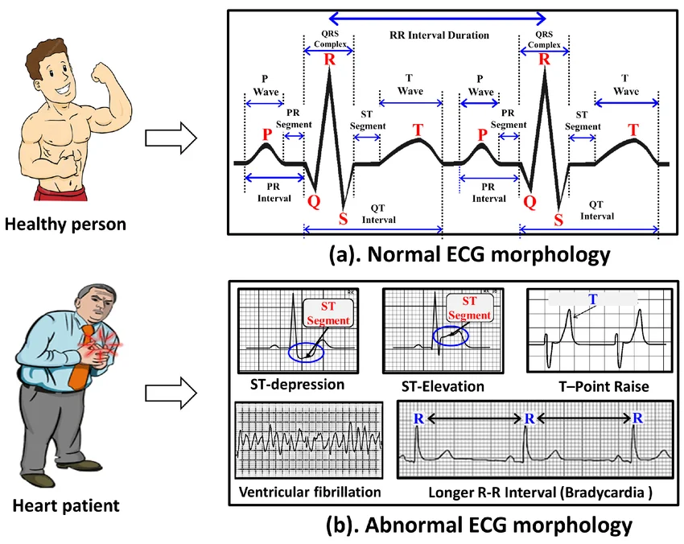
RESULTS / EXPECTED OUTPUT
• AI Model detects abnormal ECG patterns with high accuracy
• Classifies patients into Normal or Risk categories
• Provide fast and reliable predication results
• Supports doctors in early diagnosis and decision-making
• Helps reduce risk through early intervention
Accuracy : 90%+
ECG SIGNAL
AI MODEL
CLASSIFICATION
PREDICATION

Slide 10
CONCLUSION
• The proposed AI system analyzes day-long ECG signals effectively.
• Machine learning models detect abnormal heart patterns.
• The system predicts the risk of heart failure at an early stage.
• Early prediction can help doctors provide better treatment.
• AI-based healthcare systems can improve patient monitoring and diagnosis.

Slide 11

THANK YOU
ANY QUESTIONS ?
Presented by
PRAGATHEESVAR A
MOHAMED NIFRAS S.S
POOVARASAN K
PARTHIBAN S
PRADEEP S

